Slide 1
Dr. Maher jabbar salih
Medical oncologist
Al-basrah onco. Centre
Lecturer at al-basrah medicine college
2021
Lecture :MM

Slide 2
Multiple myeloma:
Pathogenesis :
This is a malignant proliferation of plasma cells.
Normal plasma cells are derived from B cells and produce immunoglobulins that contain heavy and light chains.
Normal immunoglobulins are polyclonal, which means that a variety of heavy chains are produced and each may be of kappa or lambda light chain type.

Slide 3
While in myeloma : plasma cells produce immunoglobulin of a single heavy and light chain, a monoclonal protein commonly referred to as a paraprotein or M protein .(different names)
In most cases an excess of light chain is produced, and in some cases only light chain is produced; this appears in the urine as Bence Jones proteinuria and can be measured in the urine or serum as free light chain.

Slide 4
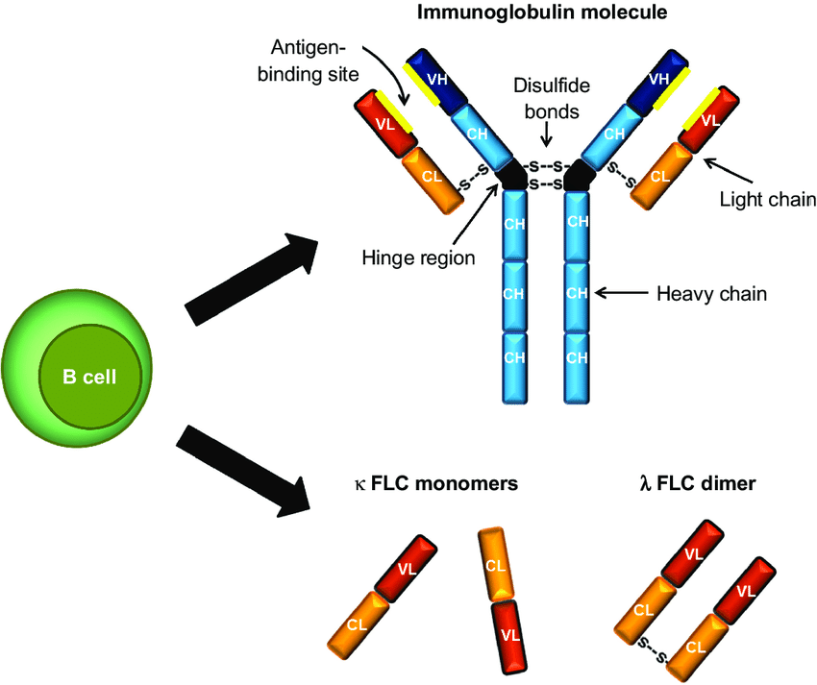

Slide 5
Types of IG

Slide 6
Etiology :
Not well known .
Genitic factors plus enviromental factors may be involved .

Slide 7
Pathology.
The malignant cells present in the bone marrow in large number on expense on the other bone marrow elements to result in different degrees of cytopenias and also secrete cytokines that cause lytic bone leasions with subsequent pathological fracture and hypercalcemia .
The produced immunoglobulin is functionless inspight of being in large amount (immunoparesis ) to result in opportunistic infection by encapsulated microorganism .
Hypercalcemia can cause renal impairment .

Slide 8
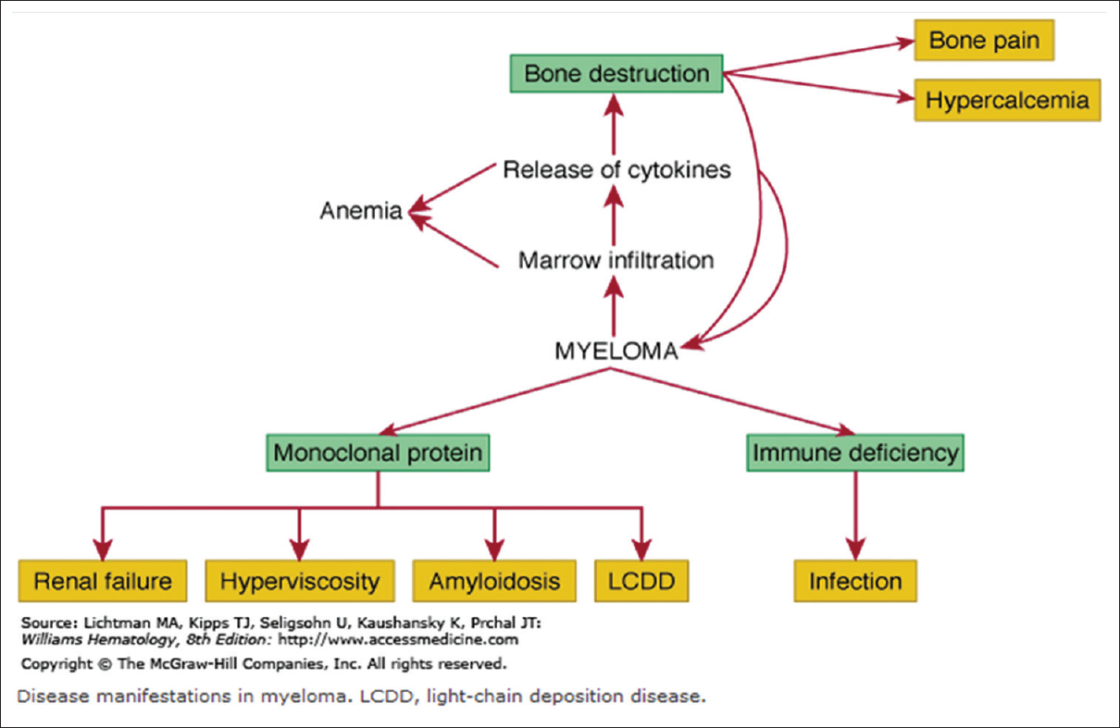
Pathology

Slide 9
Natural history

Slide 10
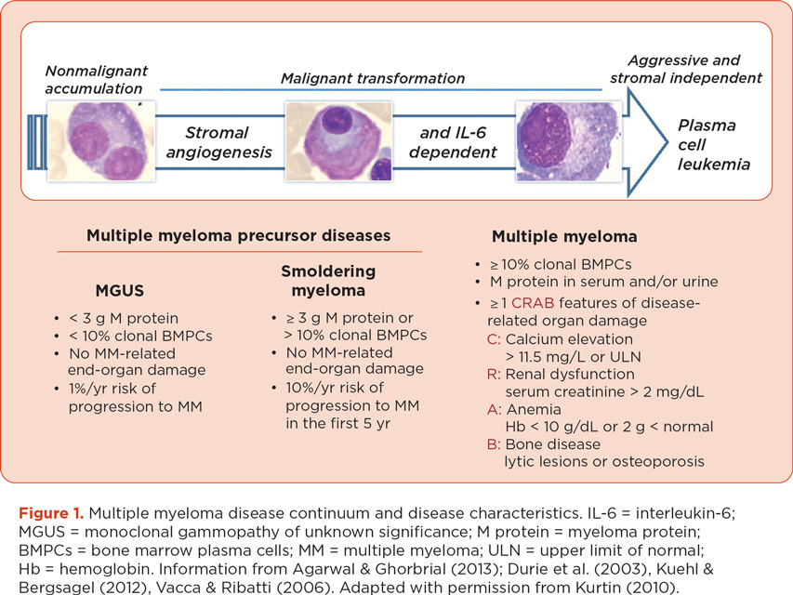

Slide 11
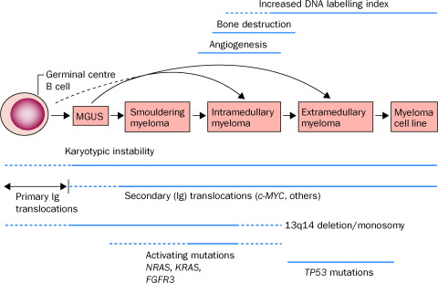

Slide 12
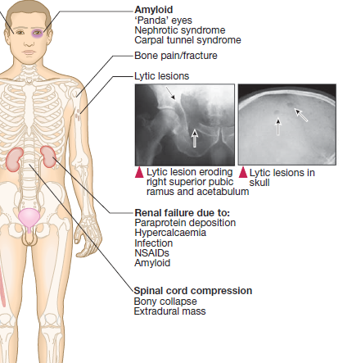
Clinical features

Slide 13
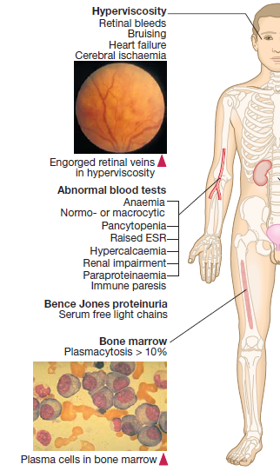

Slide 14
Diagnosis:
Diagnosis of myeloma requires two of the following criteria to be fulfilled:
1- increased malignant plasma cells in the bone marrow(>10%).
2- serum and/or urinary M-protein
3- skeletal lytic lesions

Slide 15
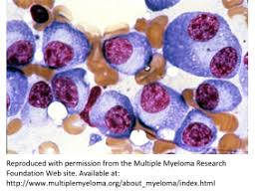

Slide 16
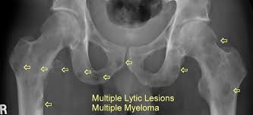

Slide 17
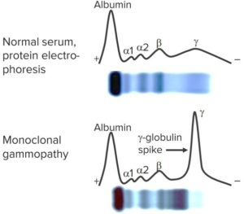
M- protein

Slide 18
Why renal failure :
Paraprotein nephropathy .
Hypercalcemia /hyperuricemia.
Infection .
Dehydration .
Medication …NSAID –induced nephropathy .
Amyloidosis/and light chain disease .

Slide 19
Management
1- MGUS ………….observation ?why
2-Asymptomatic (smouldering )myloma
…close observation ?why
3-asymptomatic but (plasma cells >60%)…needs treatment.?
4-Symptomatic type always needs treatment :
Symptoms defined by CRAB (hypercalcemia ,renal impairment , anemia , bone leasion ).

Slide 20
Immediate support..nonspecific treatment
High fluid intake to treat renal impairment and
Hypercalcaemia.
Analgesia for bone pain…try to avoid NSAID ?
Antibiotics.
Bisphosphonates for hypercalcaemia and to delay other skeletal related events.
Calcitonin may be needed for rapid action .
Allopurinol to prevent urate nephropathy.
Plasmapheresis, if necessary, for hyperviscosity.

Slide 21
Specific treatment :
Combination of agents , many protocols:
Old age pt….melphalan-prdnisolon-thalidomid.
Younger age ….velcade –dexamethazon-(endoxan or thalidomide).
After that BMT is considered for transplant eligible pt., while Non transplant eligible will be kept on maintenance treatment.

Slide 22
Specific side effects of treatment :
Thalidomide /leolidomide …teratogenic agents and cytopenias.
Velcade (bortizomib )…peripheral neuropathy.
Steroid …many side effects (…)

Slide 23
Prognosis:
Depend on the staging system at time of DX
Stage 1(normal albumin and normal B2 microglobulin <3.5mg /dl)…..median survival 62 months .
Stage 3(high B2 microglobulin >3.5 mg /dl and low albumin )…29 months only .

Slide 24
Thanks

